Slide 1
Around the world in 80 books
Travel the world through reading

Slide 2

Europe
Olivia goes to Venice
By
Ian Falconer
Which Country?
Italy

Slide 3

Europe
The Cow who Fell in the Canal
By
Phyllis Krasilovsky
Which Country?
Netherlands

Slide 4

Europe
12 Dancing Princesses
By
Alison Jay
Which Country?
Germany

Slide 5

Europe
Madeline
By
Ludwig Bemelmans
Which Country?
France

Slide 6
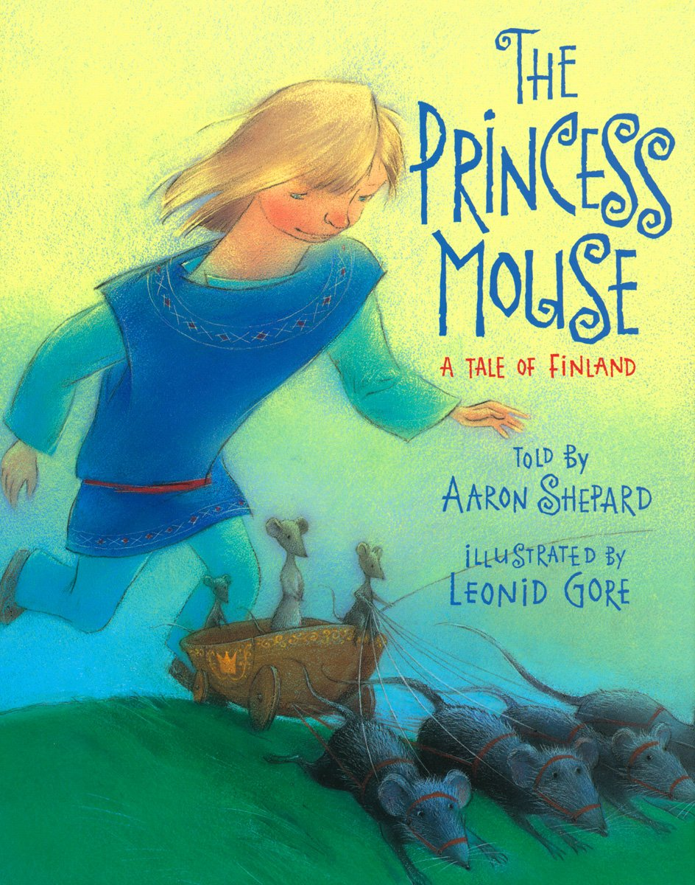
Europe
The Princess Mouse
By
Aaton Shepard
Which Country?
Finland

Slide 7

Europe
The Boy, The Bear, The Baron, The Bard
By
Gregory Rogers
Which Country?
England

Slide 8

Europe
The Ugly Duckling
By
Hans Christian Anderson
Which Country?
Denmark

Slide 9

Europe
Peter and the Wolf
By
Diane Redmond
Which Country?
Russia

Slide 10

Europe
Pippi Longstocking
By
Astrid Lindgren
Which Country?
Sweden

Slide 11

Europe
KeeKee’s Big Adventures in Athens, Greece
By
Shannon Jones
Which Country?
Greece

Slide 12

Europe
Katie in Scotland
By
James Mayhew
Which Country?
Scotland

Slide 13

Europe
Irish Fairy Tales and Legends
By
Una Leavy
Which Country?
Ireland

Slide 14

Asia
Dim Sum for Everyone
By
Grace Lin
Which Country?
China

Slide 15
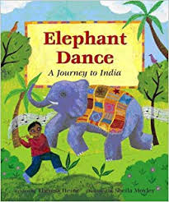
Asia
Elephant Dance
By
Theresa Heine
Which Country?
India

Slide 16

Asia
The Secret Message
By
Mina Javaherbin
Which Country?
Iran

Slide 17

Asia
Hachiko
By
Pamela S. Turner
Which Country?
Japan

Slide 18

Asia
Wabi Sabi
By
Mark Reibstein
Which Country?
Japan

Slide 19

Asia
First Rain
By
Charlotte Herman
Which Country?
Israel

Slide 20

Asia
The Korean Cinderella
By
Shirley Climo
Which Country?
South Korea

Slide 21

Asia
Tuko and the Birds
By
Shirley Climo
Which Country?
Philippines

Slide 22

Asia
Nasreen’s Secret School
By
Jeanette Winter
Which Country?
Afghanistan

Slide 23
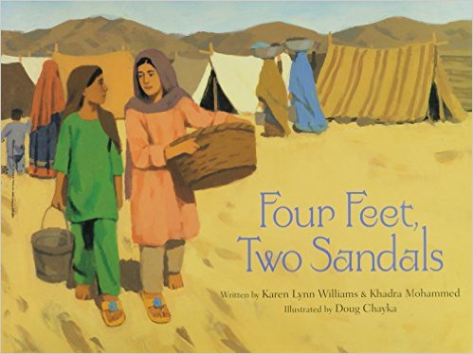
Asia
Four Feet, Two Sandals
By
Karen Lynn Williams
Which Country?
Pakistan

Slide 24

Asia
Peek
By
Minfong Ho
Which Country?
Thailand

Slide 25

Asia
Hanuman and the Orange Sun
By
Amy Maranville
Which Country?
India

Slide 26

Asia
Amal’s Eid
By
Amy Maranville
Which Country?
India

Slide 27

AFrica
Africa is Not a Country
By
Margy Burns Knight
Which Country?
All

Slide 28

Africa
Mama Panya’s Pancakes
By
Mary and Rich Chamberlain
Which Country?
Kenya

Slide 29

Africa
Mufaro’s Beautiful Daughters
By
John Steptoe
Which Country?
Zimbabwe

Slide 30

Africa
The Mother of Monsters
By
Fran Parnell
Which Country?
South Africa

Slide 31

Africa
Pretty Salma
By
Niki Daly
Which Country?
Ghana

Slide 32
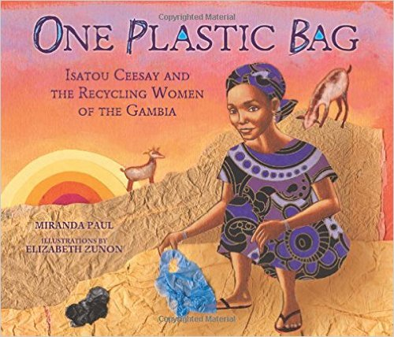
Africa
One Plastic Bag
By
Miranda Paul
Which Country?
Gambia

Slide 33

Africa
We All Went on Safari
By
Laurie Krebs
Which Country?
Tanzania

Slide 34

Africa
Grandpa Cacao
By
Elizabeth Zunon
Which Country?
Ivory Coast

Slide 35

Africa
The Leopard’s Drum
By
Jessica Souhami
Which Country?
Ghana

Slide 36
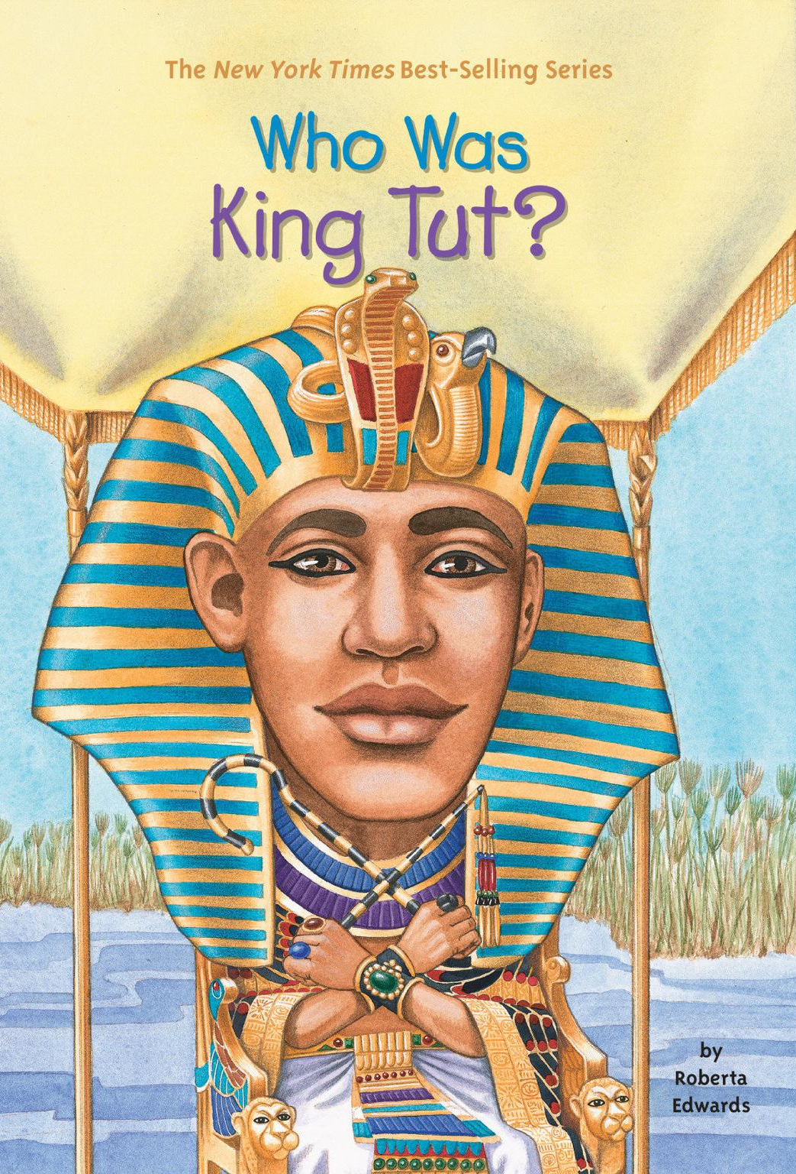
Africa
Who was King Tut?
By
Roberta Edwards
Which Country?
Ghana

Slide 37

Africa
The Lion’s Whiskers
By
Nancy Raines Day
Which Country?
Ethiopia

Slide 38

Africa
I Lost My Tooth in Africa
By
Penda Diakite
Which Country?
Mali

Slide 39

Africa
Anansi the Spider
By
Gerald McDermott
Which Country?
Ghana

Slide 40
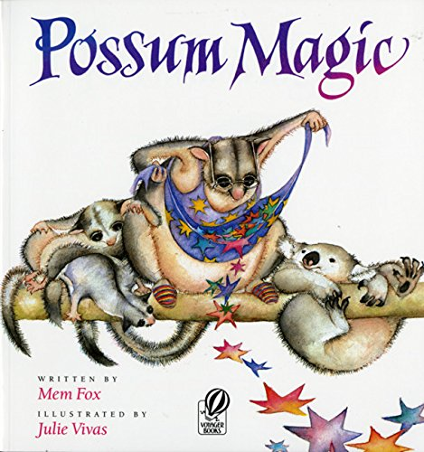
OCEANIA
Possum Magic
By
Mem Fox
Which Country?
Australia

Slide 41

OCEANIA
Where’s Stripey?
By
Wendy Binks
Which Country?
Australia

Slide 42

OCEANIA
Diary of a Wombat
By
Jackie French
Which Country?
Australia

Slide 43

OCEANIA
New Zealand ABCs
By
Holly Schroeder
Which Country?
New Zealand

Slide 44

OCEANIA
D is for Down Under
By
Devin Scillian
Which Country?
Australia

Slide 45

OCEANIA
Elizabeth, Queen of the Seas
By
Lynne Cox
Which Country?
New Zealand

Slide 46

OCEANIA
Hello, Mama Wallaroo
By
Darrin Lunde
Which Country?
Australia

Slide 47

OCEANIA
My Ocean Home Fiji
By
Penelope Casey
Which Country?
Fiji

Slide 48
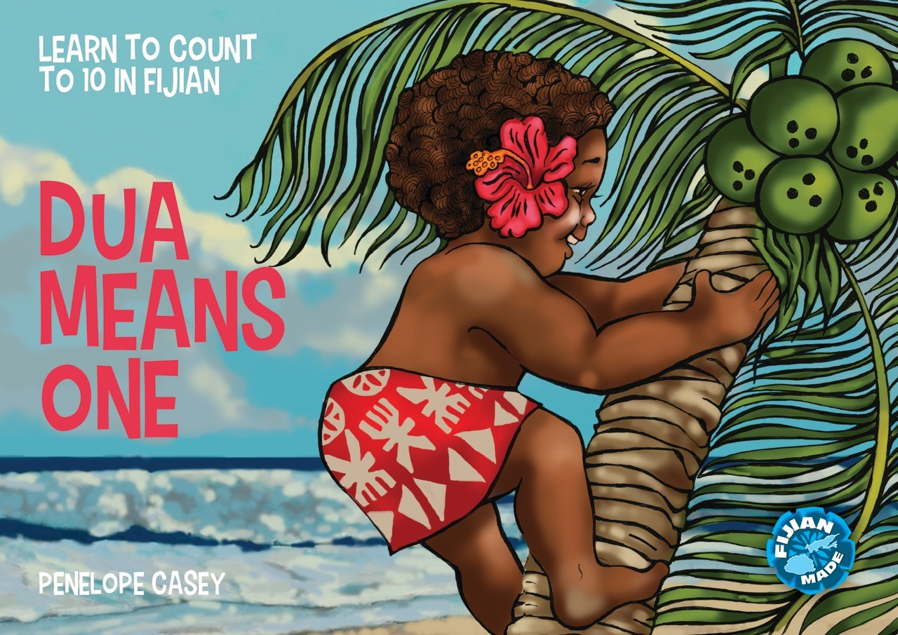
OCEANIA
Dua Means One
By
Penelope Casey
Which Country?
Fiji

Slide 49

OCEANIA
The Lighthouse Keeper’s Christmas
By
Ronda and David Armitage
Which Country?
New Zealand

Slide 50

OCEANIA
The Turtle and the Island
By
Barbara Ker Wilson
Which Country?
Papua New Guinea

Slide 51

OCEANIA
Tasi’s Gift
By
Tamara Montgomery
Which Country?
Samoa

Slide 52

OCEANIA
Dolphins in Danger
By
Amanda Lumry
Which Country?
French Polynesia

Slide 53

North America
Caribbean Dream
By
Rachel Isadora
Which Country?
Caribbean

Slide 54
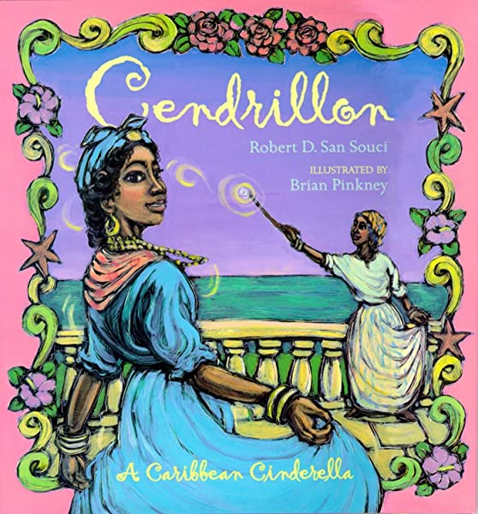
North America
Cendrillion
By
Robert D. San Souci
Which Country?
Caribbean

Slide 55

North America
Martina the Beautiful Cockroach
By
Carmen Agra Deedy
Which Country?
Cuba

Slide 56

North America
Frida
By
Jonah Winter
Which Country?
Mexico

Slide 57

North America
Adelita
By
Tomie de Paola
Which Country?
Mexico

Slide 58

North America
Dawn Watch
By
Jean E. Pendziwol
Which Country?
Canada

Slide 59

North America
Off We Go to Mexico!
By
Laurie Krebs and Christopher Corr
Which Country?
Mexico

Slide 60

North America
The Wheels on the Bus
By
Barefoot Books
Which Country?
Guatemala

Slide 61

North America
Parrots over Puerto Rico
By
Cindy Trumbore
Which Country?
Puerto Rico

Slide 62

North America
Drum Dream Girl
By
Margarita Engle
Which Country?
Cuba

Slide 63

North America
A Chip Off the Old Block
By
Jody Jensen Shaffer
Which Country?
USA

Slide 64

North America
The 50 States
By
Gabrielle Balkan
Which Country?
USA

Slide 65

North America
How to Make a Cherry Pie and See the USA
By
Marjorie Priceman
Which Country?
USA

Slide 66

North America
Our Great Big Backyard
By
Laura Bush and Jenna Bush Hager
Which Country?
USA

Slide 67

South America
We’re Roaming in the Rainforest
By
Laurie Krebs and Anne Wilson
Which Country?
Peru

Slide 68

South America
Ada’s Violin
By
Susan Hood
Which Country?
Paraguay

Slide 69

South America
Love and Roast Chicken
By
Barbara Knutson
Which Country?
Peru

Slide 70

South America
Waiting for the Biblioburro
By
Monica Brown
Which Country?
Columbia

Slide 71

South America
The Dancing Turtle
By
Pleasant DeSpain
Which Country?
Brazil

Slide 72
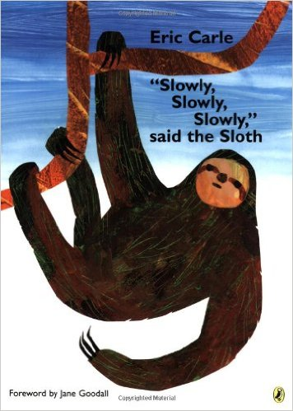
South America
Slowly, Slowly, Slowly Said the Sloth
By
Eric Carle
Where?
Amazon

Slide 73
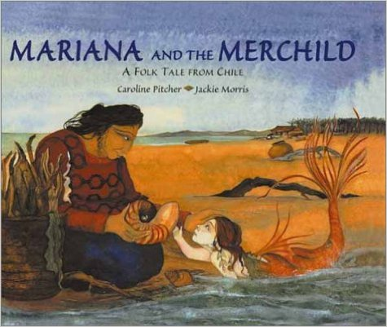
South America
Mariana and the Merchild
By
Caroline Pitcher
Which Country?
Chile

Slide 74

South America
Soccer Star
By
Mina Javaherbin
Which Country?
Brazil

Slide 75

South America
Carolina’s Gift
By
Katacha Diaz
Which Country?
Peru

Slide 76

South America
The Magic Bean Tree
By
Nancy Van Laan
Which Country?
Argentina

Slide 77

South America
Up and Down the Andes
By
Laurie Krebs and Aurelia Fronty
Which Country?
Peru

Slide 78

South America
Tomas and the Galapagos Adventure
By
Carolyn Lunn
Which Country?
Galapagos Islands

Slide 79

South America
We’re Sailing to Galapagos
By
Laurie Krebs
Which Country?
Galapagos Islands

Slide 80

Antarctica
Sophie Scott Goes South
By
Alison Lester
Which Country?
Antarctica

Slide 81

Antarctica
Shackleton’s Journey
By
Willian Grill
Which Country?
Antarctica

